Slide 1
70-533 : Implementing Microsoft Azure Infrastructure Solutions

Slide 2
Configure Cloud Services

Slide 3
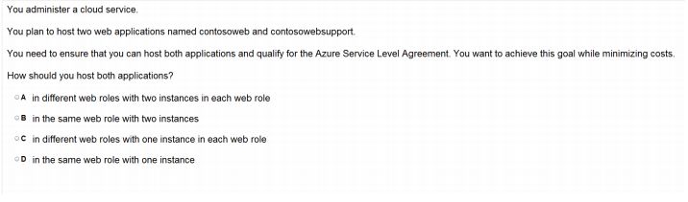
Ans – B What to Explain Explain Cloud Service and Web Roles

Slide 4
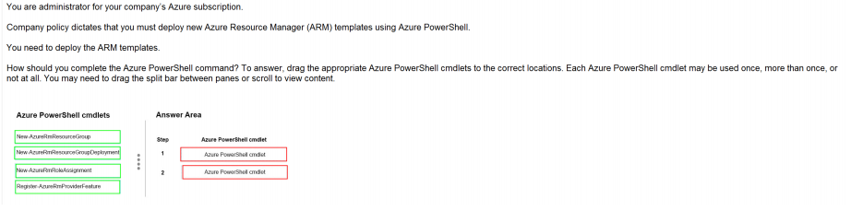
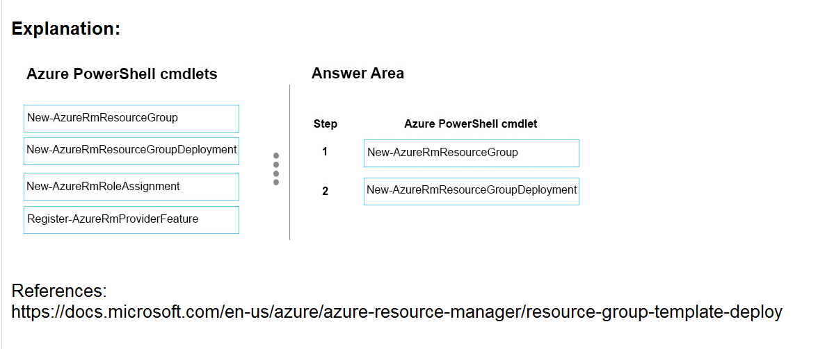
Ans =

Slide 5
Description
The New-AzureRmResourceGroup cmdlet creates an Azure resource group. You can create a resource group by using just a name and location, and then use the New-AzureRmResource cmdlet to create resources to add to the resource group. To add a deployment to an existing resource group, use the New-AzureRmResourceGroupDeployment cmdlet.
To add a resource to an existing resource group, use the New-AzureRmResource cmdlet. An Azure resource is a user-managed Azure entity, such as a database server, database, or website. An Azure resource group is a collection of Azure resources that are deployed as a unit.

Slide 6
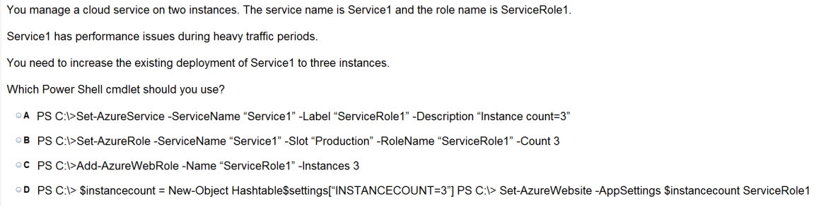
Ans = B

Slide 7
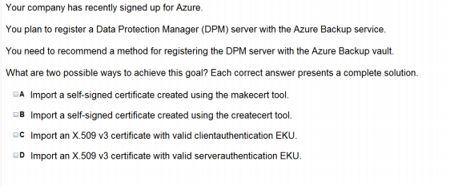
Ans = A & C

Slide 8
Deploy and manage Cloud Services

Slide 9
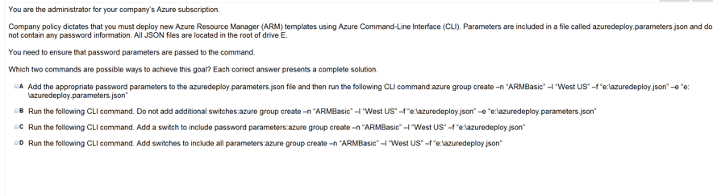
Ans = B & D

Slide 10
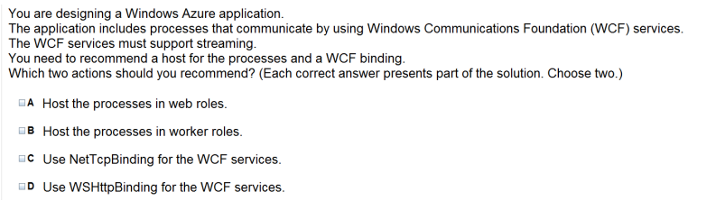
Ans = B & C

Slide 11
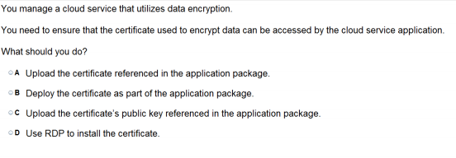
Ans – A

Slide 12
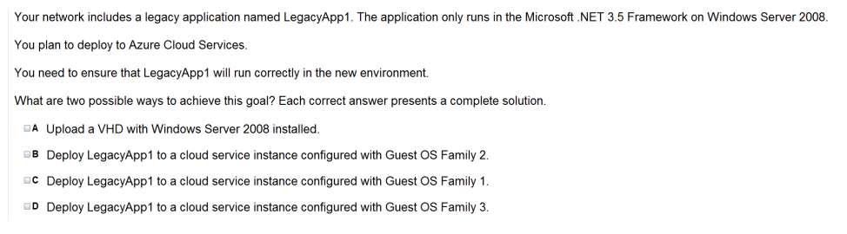
Ans = A & B Family 2 releases Windows Server 2008 R2 SP1 Family 3 releases Windows Server 2012 Family 4 releases Windows Server 2012 R2

Slide 13
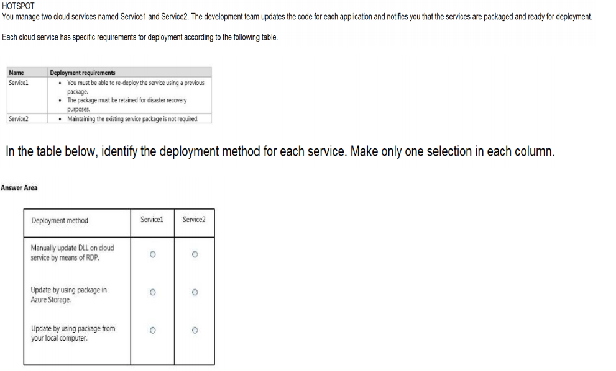
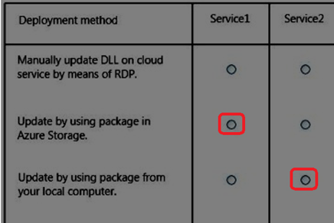
Ans =

Slide 14
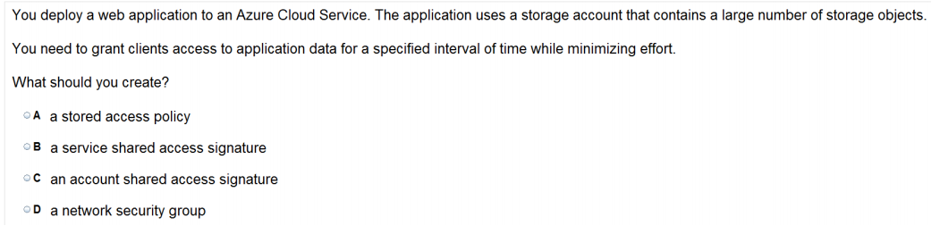
Ans =C

Slide 15
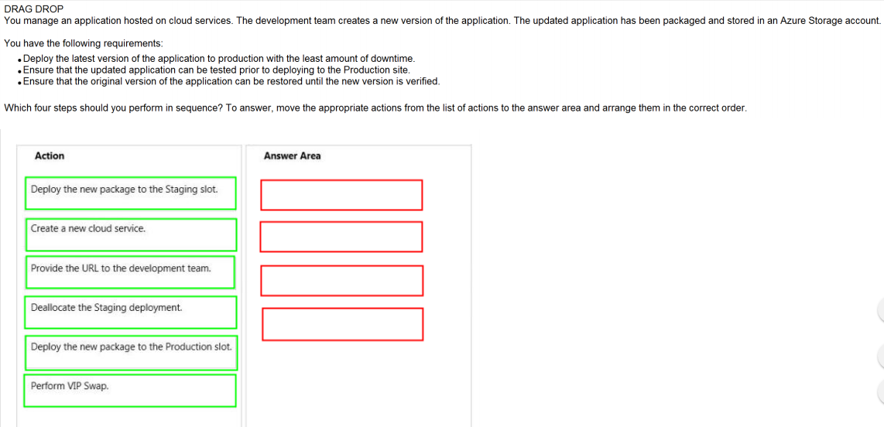
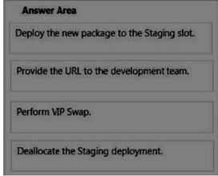
Ans =

Slide 16
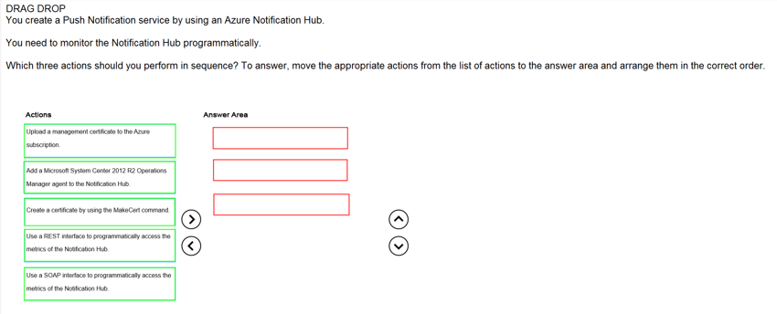
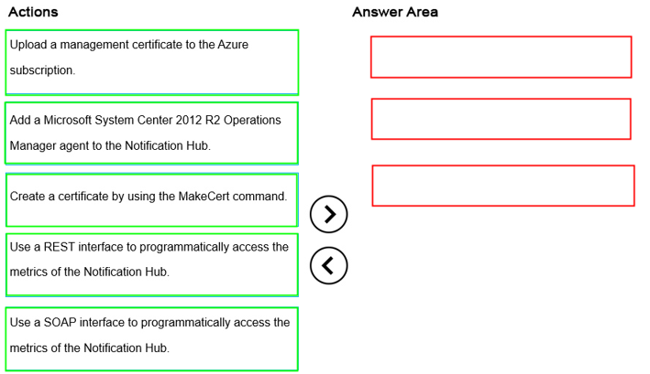
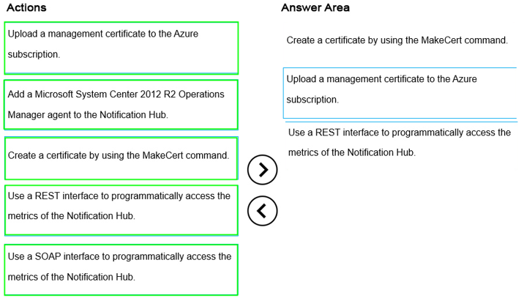
Ans =

Slide 17
Monitor Cloud Service

Slide 18
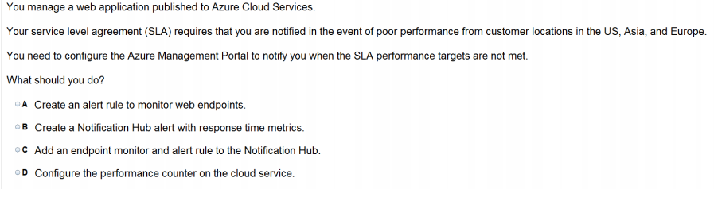
Ans = A

Slide 19
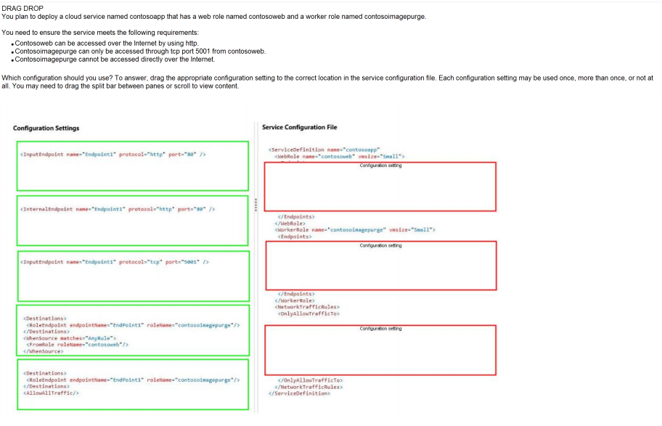
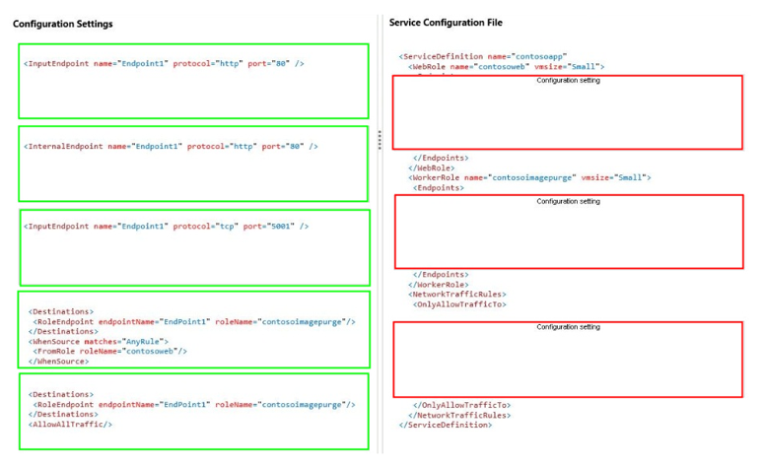
Ans =

Slide 20
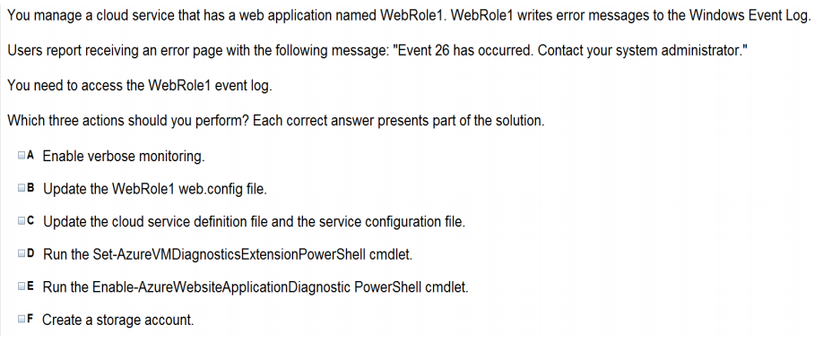
Ans = A & C & F

Slide 21
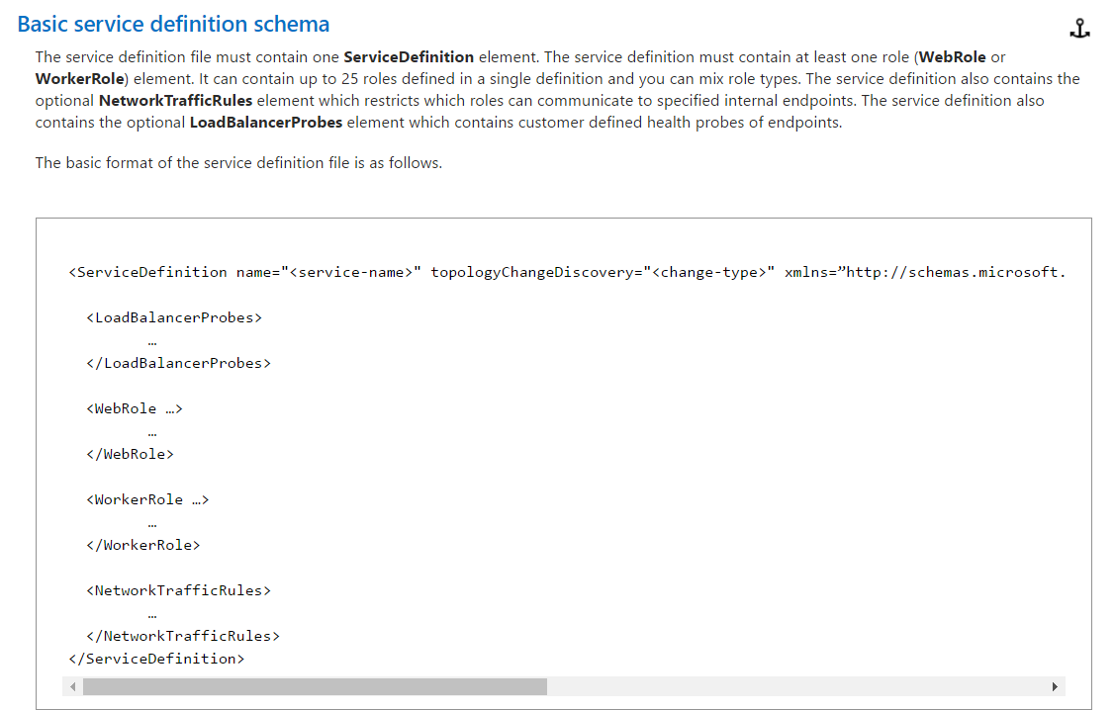
The service definition file defines the service model for an application. The file contains the definitions for the roles that are available to a cloud service, specifies the service endpoints, and establishes configuration settings for the service.

Slide 22
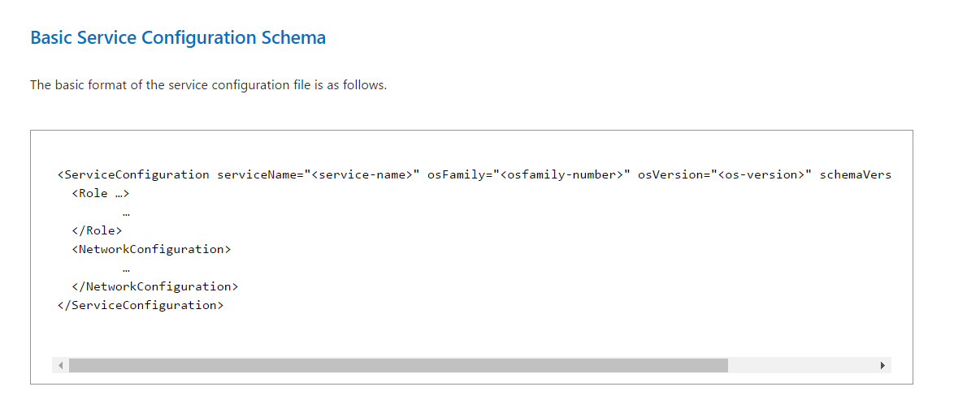
The service configuration file specifies the number of role instances to deploy for each role in the service, the values of any configuration settings, and the thumbprints for any certificates associated with a role. If the service is part of a Virtual Network, configuration information for the network must be provided in the service configuration file, as well as in the virtual networking configuration file.

Slide 23
Azure Service Bus

Slide 24
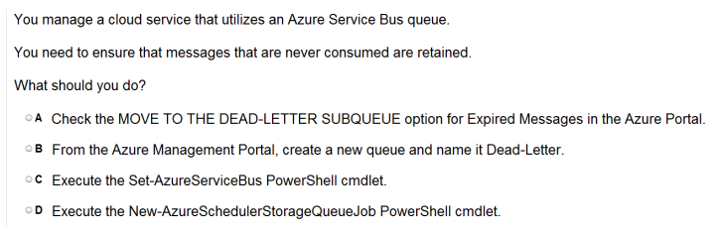
Ans =A

Slide 25
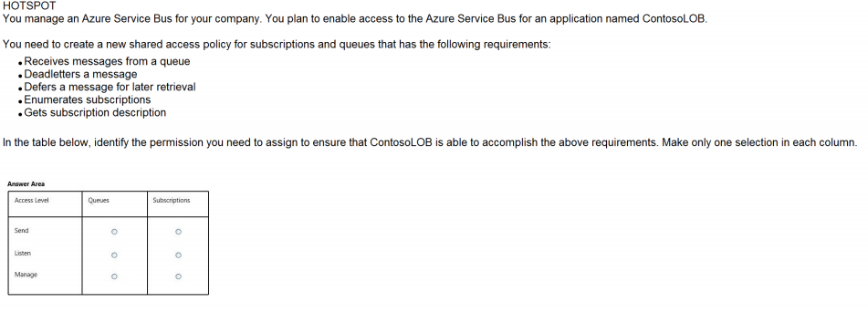
Ans – Queue – Listen Subscriptions - Manage

Slide 26
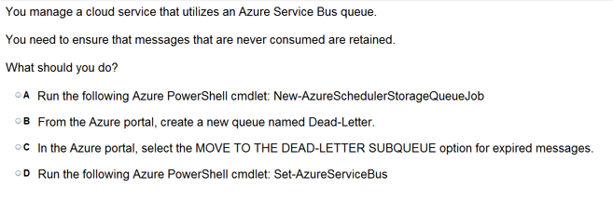
Ans =C

Slide 27
Azure Back up

Slide 28
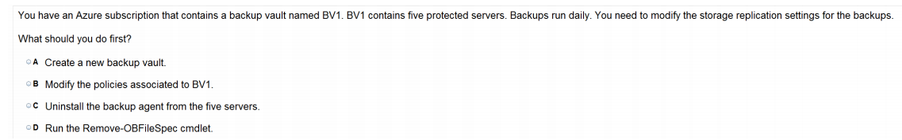
Ans =B
Azure Backup is the Azure-based service you can use to back up (or protect) and restore your data in the Microsoft cloud. Azure Backup replaces your existing on-premises or off-site backup solution with a cloud-based solution that is reliable, secure, and cost-competitive.
Azure Backup offers multiple components that you download and deploy on the appropriate computer, server, or in the cloud. The component, or agent, that you deploy depends on what you want to protect. All Azure Backup components (no matter whether you're protecting data on-premises or in the cloud) can be used to back up data to a Backup vault in Azure.

Slide 29
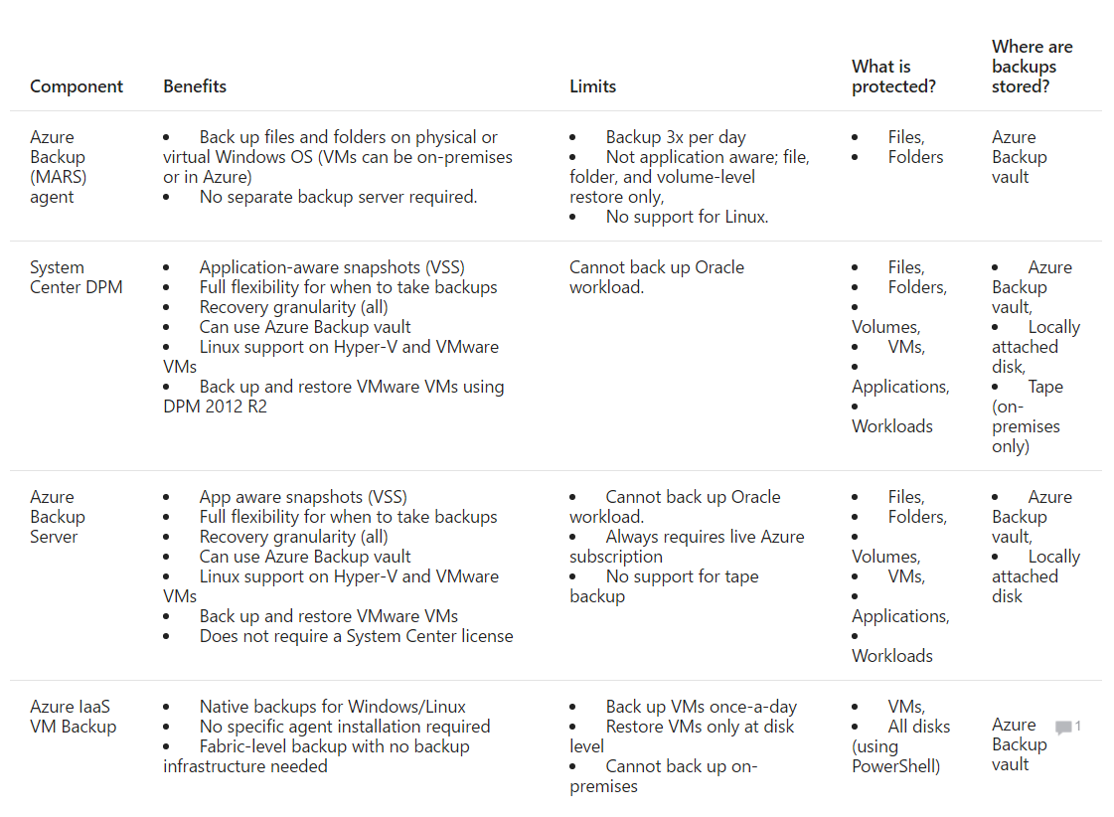

Slide 30
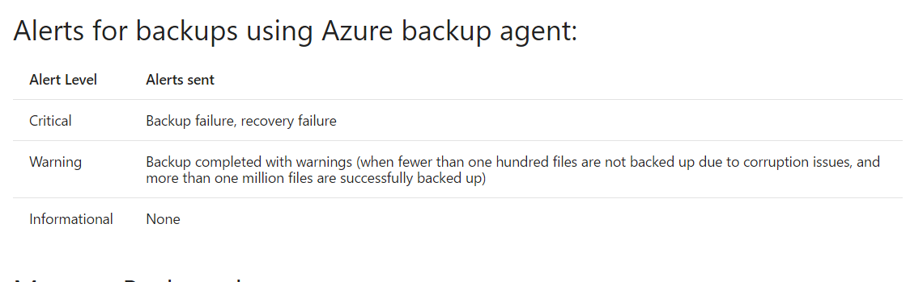

Slide 31
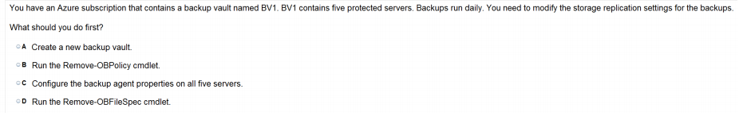
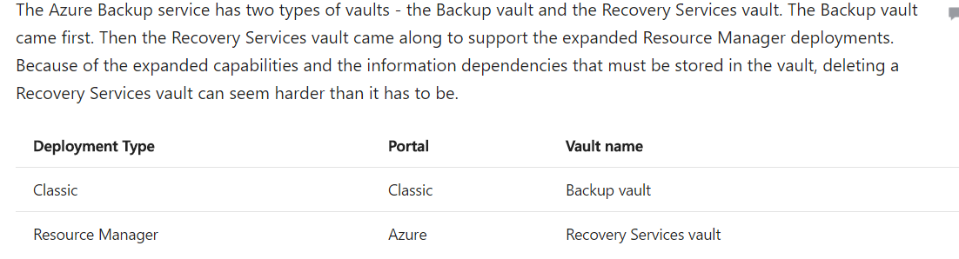
Ans = C

Slide 32
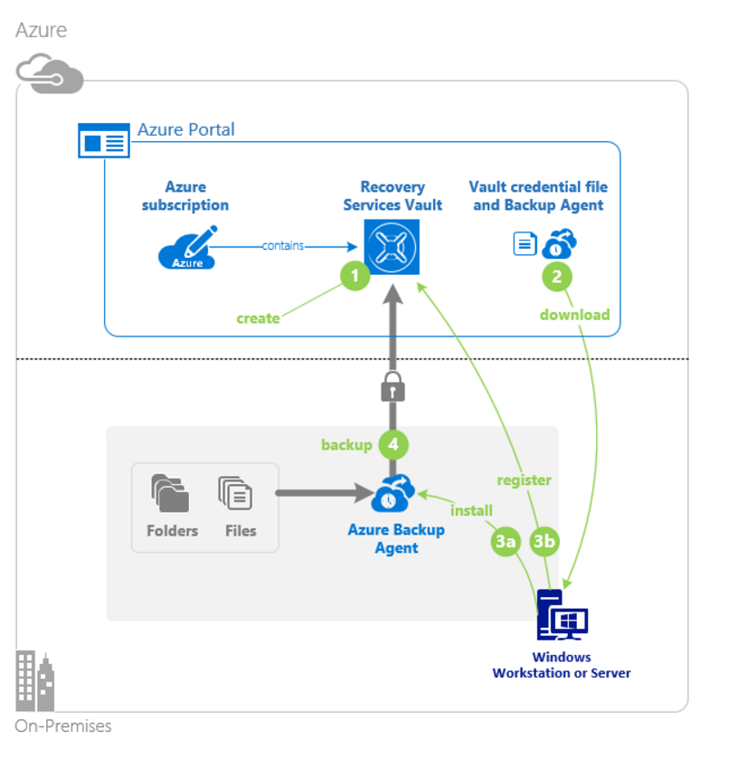
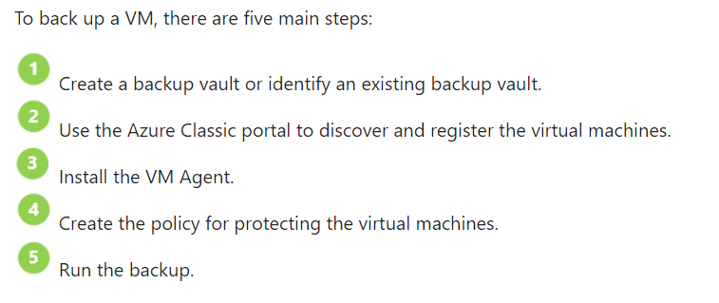

Slide 33
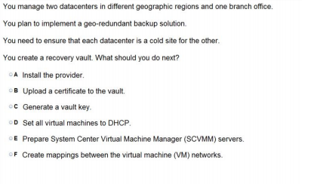
Ans – C

Slide 34
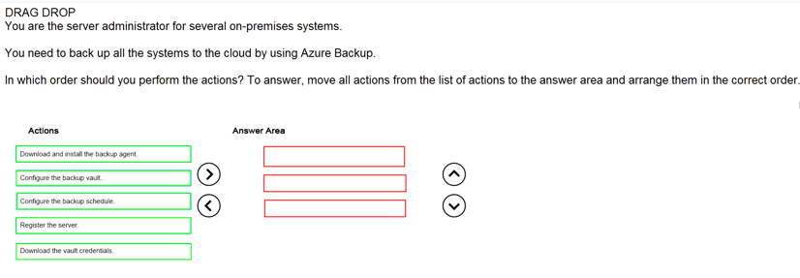
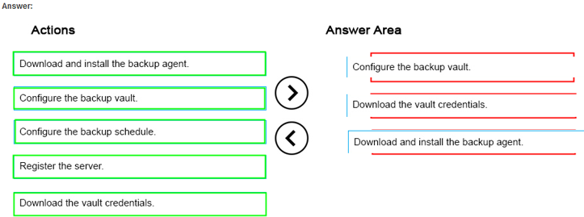
Ans =

